Slide 1
Move Fast and Break Everything
Testing major changes to a core component of GNOME
Sam Thursfield
GUADEC 2020

Slide 2
Move Fast and Break Everything
Part 1. Get to know your daemons
Why does GNOME provide system services?
Part 2. Learn to control them
Testing changes to the Tracker search engine

Slide 3
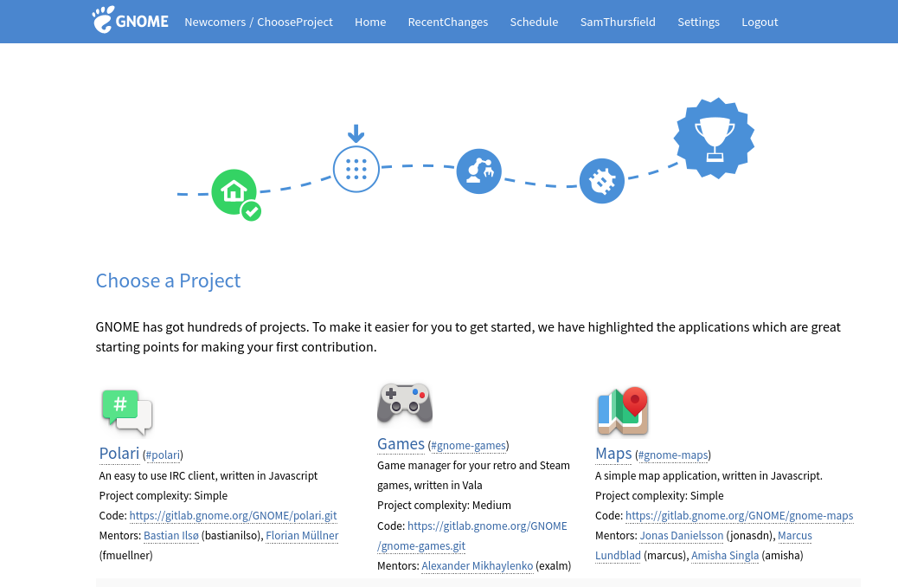
https://wiki.gnome.org/Newcomers/ChooseProject
Part 1. Get to know your daemons

Slide 4


What is it?
Part 1. Get to know your daemons

Slide 5
Apps Shell
Music, Photos, Web, …
Part 1. Get to know your daemons

Slide 6

Apps Shell
Music, Photos, Web, …
???
Part 1. Get to know your daemons

Slide 7
Apps Shell
Music, Photos, Web, …
Services
dconf
evolution-data-server
NetworkManager
GNOME Keyring
Tracker upower
...and 10s more...
Libraries
GStreamer
GTK PyGObject
libnotify
WebKitGTK
...and 100s more...

Slide 8

System services
May manage hardware, or a data store
Communicate over D-Bus, or by a socket
Apps access them directly or with a helper library
“Anything that wants to be running as a system service in combination with any kind of sandboxing system must have a protocol that is ABI stable and backwards compatible.”
Part 1. Get to know your daemons

Slide 9
Try this at home: pstree
systemd─┬─ModemManager───2*[{ModemManager}]
├─NetworkManager───2*[{NetworkManager}]
├─abrt-dbus───2*[{abrt-dbus}]
├─3*[abrt-dump-journ]
├─abrtd───2*[{abrtd}]
├─accounts-daemon───2*[{accounts-daemon}]
├─alsactl
├─auditd─┬─sedispatch
│ └─2*[{auditd}]
├─avahi-daemon───avahi-daemon
├─colord───2*[{colord}]
├─crond
├─cupsd
├─dbus-broker-lau───dbus-broker
├─2*[dnsmasq───dnsmasq]
├─earlyoom
├─firewalld───{firewalld}
… and 100 more...
Part 1. Get to know your daemons

Slide 10
Part 2: Control your daemons ...or better yet, hack on them.
Part 2. Control your daemons

Slide 11
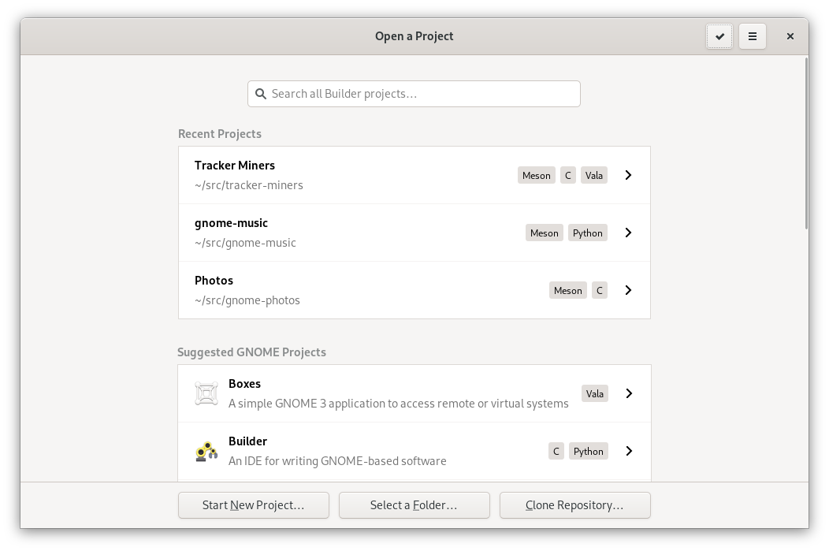
Part 2. Control your daemons

Slide 12
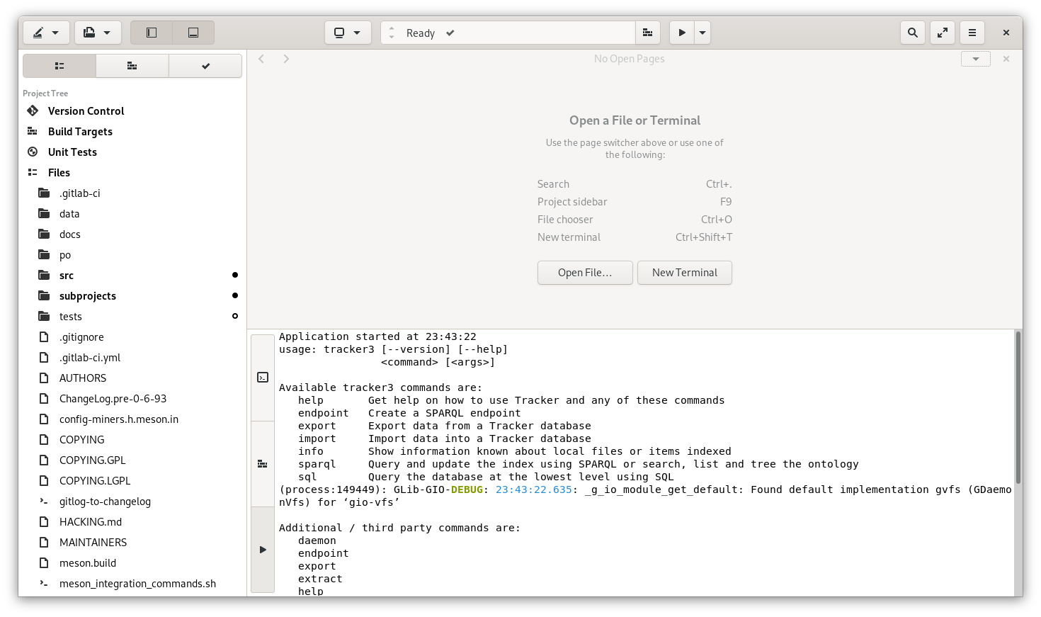
Building and running Tracker with GNOME Builder
Part 2. Control your daemons

Slide 13
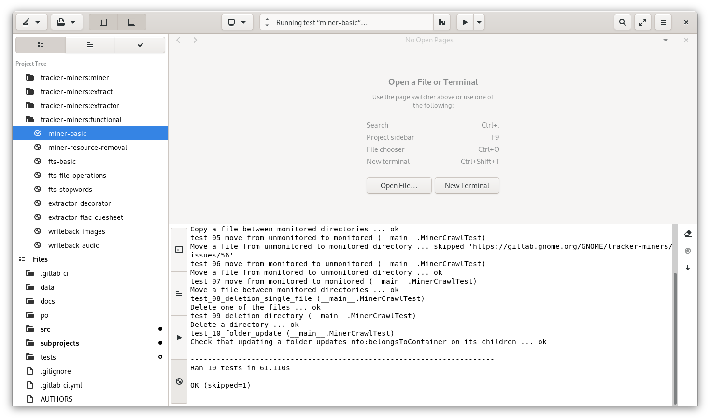
Running an automated test
Part 2. Control your daemons

Slide 14
Automated testing of daemons...
Use dbus-run-session to create a throwaway message bus.
Use umockdev to simulate real hardware.
Write tests in Python (test your bindings and/or D-Bus API for free!)
See Tracker’s tests/functional-tests for a complex example.
Part 2. Control your daemons
Part 2. Control your daemons

Slide 15

Part 2. Control your daemons

Slide 16
The best way to deploy a test build?
Run from source tree
Install into /usr
Install into /opt (jhbuild)
Use distro packaging tools
Use BuildStream to build a VM image
Part 2. Control your daemons

Slide 17
Run from the source tree
Unlikely to work, but try it!
Project can provide a helper script.
https://gitlab.gnome.org/GNOME/tracker-miners/-/blob/master/run-uninstalled.in

Slide 18

Install into /usr
Fast, easy and simple
It will break the host OS.
Part 2. Control your daemons

Slide 19
Install into /opt
Fast, and safe-ish
System integration won’t work as normal.
export XDG_DATA_DIRS=/opt/tracker3/share:/usr/share
dbus-run-session /opt/tracker3/bin/tracker3 search Foo
jhbuild can help, but you might not need it.
Part 2. Control your daemons

Slide 20
Use distro packaging tools
Reproducible and safe-ish
Use PPA for Ubuntu, COPR for Fedora, …
Turnaround time is slow (at least a few minutes)
Part 2. Control your daemons

Slide 21

Use BuildStream
Reproducible and safe
You need a VM (bst shell isn’t magic)
Building and deploying VM update took me ~20 mins
Work is ongoing to improve “GnomeOS” testing images (see Valentin’s talk)
More details:https://gitlab.gnome.org/GNOME/gnome-build-meta/-/wikis/home
Part 2. Control your daemons

Slide 22
The best way to deploy a test build?
 | Fast | Reproducible | No extra codepaths needed | No extra computer or VM needed
Run from source tree | ✓ | ✓ |  | ✓
Install into /usr | ✓ |  | ✓
Install into /opt (jhbuild) | ✓ |  |  | ✓
Use distro packaging tools |  | ✓ | ✓ | ~
Use BuildStream to build a VM image |  | ✓ | ✓
Part 2. Control your daemons

Slide 23
In summary...
Contributing to daemons shouldn’t be scary.
Do you maintain a daemon? Update the README :)
Automated testing is best
If a service project doesn’t have functional testing,
look at how to add it!
Manual testing is often needed too.
How can we make sure it’s frictionless?
Part 2. Control your daemons

